Slide 1
Data Visualization Project 1 Credit Card Customer Churn Analysis
Team 4:
Will Cutrone
Edyson Katuuo
Jess Hunter
Subhashree Mallick

Slide 2
Motivation and Summary
Customer churn is one of the most important and challenging problems for businesses today
Many businesses are utilizing customer churn metrics in order to try and predict churning and improve customer retention.

Slide 3
Questions
What factors may or may not be associated with churning?
What is the profile of someone who is likely to churn?
After determining the profile, which percent of existing customers are now at risk for churning?

Slide 4
Data Cleanup & Exploration
Data Source: BankChurners.csv via Kaggle.com
Pandas was used to create a dataframe from the csv
In terms of cleaned data, the most significant edit to the data was that we eliminated all customers with a utilization ratio of 0 (aka they never used the card)
Keeping zero utilization customer data led to misleading representations
Two extraneous columns were deleted as they did not contribute to the analysis

Slide 5
Data Analysis
Each variable (or column in the datasheet) was investigated whether it did or did not have a statistically significant effect in predicting those at risk for churning via using Matplotlib to create various diversified plots
After plots were created by using the independent t-test on all factors, we determined which factors were statistically significant and came up with a basic profile of a customer that we believe is at risk for churning

Slide 6
Variables Examined for Investigation
Age
Income
Utilization Ratio
Transaction Amount
Transaction Count
Months Inactive
Gender
Marital Status
Dependents
Monthly Credit Limit
Months with the Company

Slide 7
Quantitative Data
Utilization Ratio
Months Spent
Monthly Credit Limit
Total Revolving Balance

Slide 8
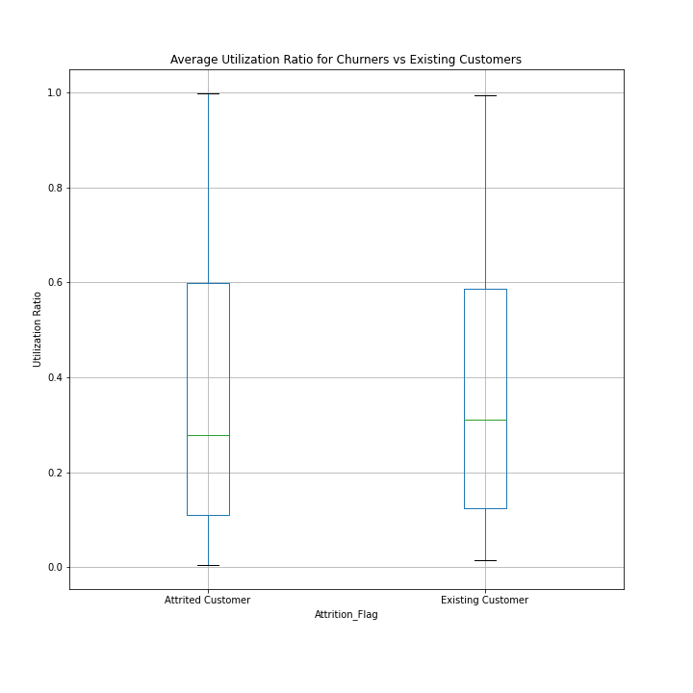
Utilization Ratio
P-value
0.73
Note
Surprisingly, both groups appear to have a low utilization ratio.

Slide 9
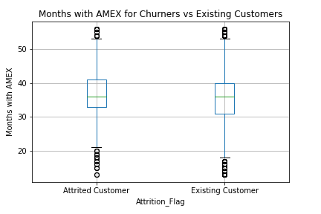
Months Spent
P-value
0.11

Slide 10
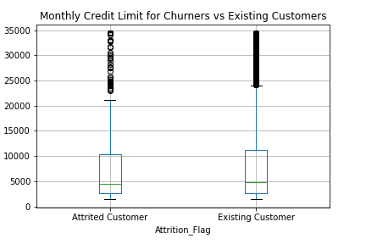
Monthly Credit Limit
P-value
0.73

Slide 11
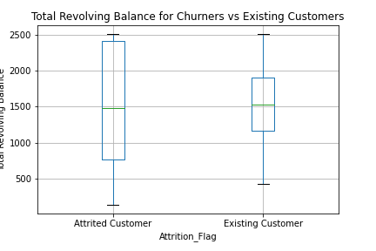
Total Revolving Balance
P-value
0.09

Slide 12
Categorical Data
Gender
Education Level
Marital Status
Income_Category
Dependent Count
Card Category
Customer Age

Slide 13
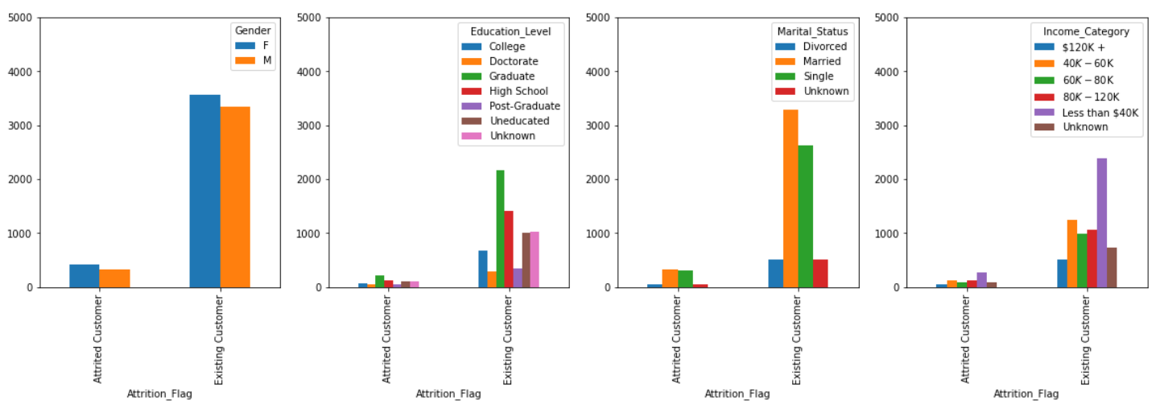
Gender, Education Level, Marital Status & Income
Notes:
Dsd
Ddsd
Dssssssssssssssssssssss
Dddddddddddddddddddddddddddddddddddddd
D
Dssssssssssssssssssssssssss

Slide 14
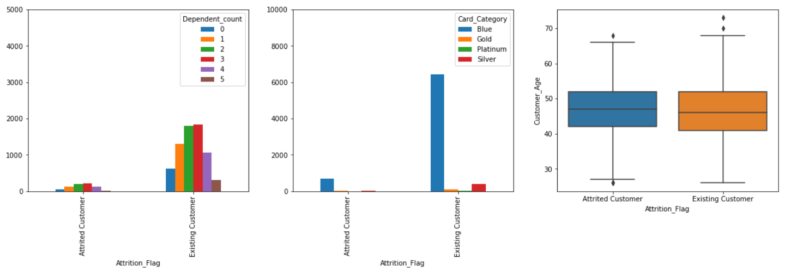
Dependent Count, Card Category & Age

Slide 15
Statistically Significant Areas
Total Transaction Amount
Total Transaction Count
Months Inactive Out of 12 Months

Slide 16
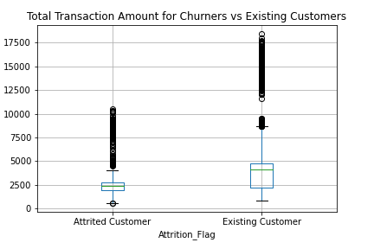
Total Transaction Amount
Churners
Mean= $3,148.97
Median= $2,361.00
Std = $2,357
Existing
Mean = $4,861.27
Median = $4,081.00
Std = $3611.78
P-value
9.9e-51

Slide 17
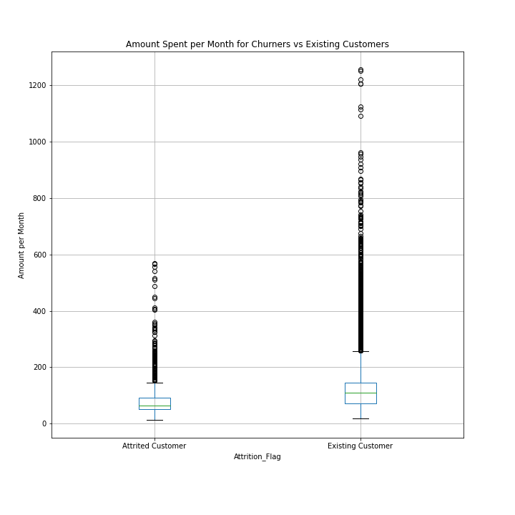
Transaction Amount (by month)

Slide 18
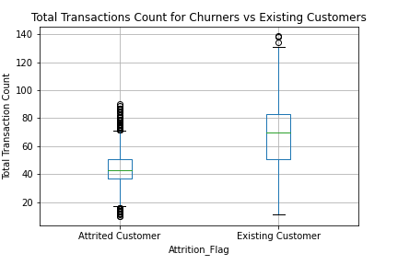
Total Transaction Count
Churners
Mean: 45
Median: 43
Standard Deviation: 14.38
Existing Customers
Mean: 68
Median: 70
Standard Deviation: 24
P-value
6.9e-212

Slide 19
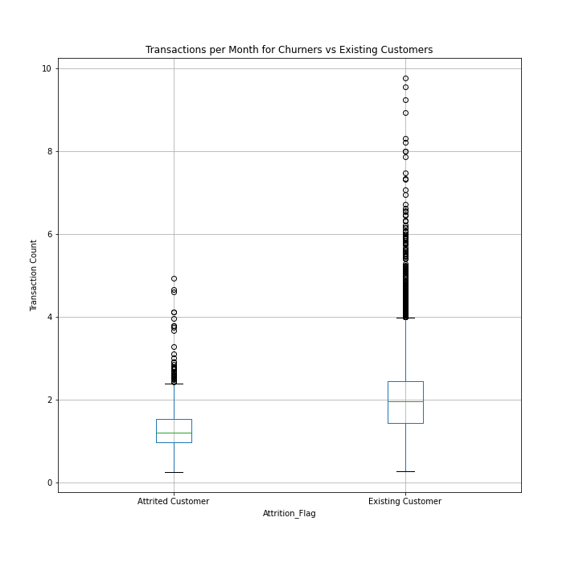
Transaction Count (but by month)

Slide 20
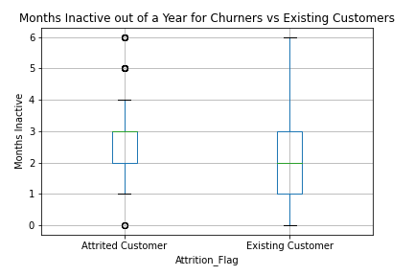
Months Inactive
Churners
Mean: 2.73
Median: 3
Standard Deviation: 0.9
Existing Customers
Mean: 2.27
Median: 2
Standard Deviation: 1.02
P-value
2.8e-35

Slide 21
Profile of a Churner
Total Trans Count < 51
Months Inactive > 3

Slide 22
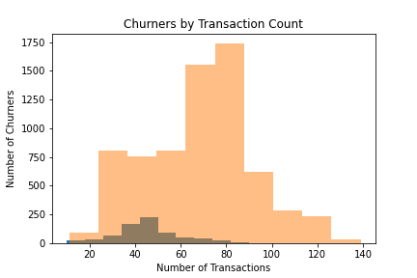
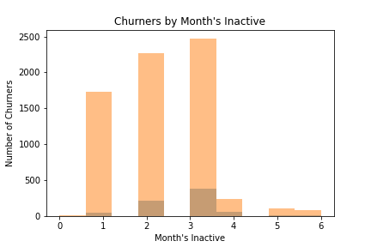
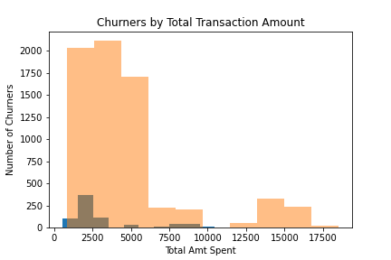

Slide 23
Risk of Existing Customer Churn
Existing customers who meet both conditions - 1%
Existing customers who meet either condition - 35%

Slide 24
Limitations
This dataset contains data from more than 10,000 credit card accounts with 19 variables and is heavily imbalanced with 84% of customers existing, leaving only 16% attrited
There are many more customers staying with the company than leaving the company which causes imbalances in the data and has an impact on the prediction model development
Data may be skewed by card category (revolving balance cards vs monthly pay in full cards)

Slide 25
Additional Areas Worth Exploring
Some important variables were not included in the dataset that contributed to limitations in the analysis but would be worth exploring:
Customer credit score
Annual percentage rate per card
Special offer such as 0% or low APR for a particular time period
Time period of dataset collection
Geographic location

Slide 26
Questions?

